Slide 1

Chapter 3 Selection Statements

Slide 2
Objectives
To declare bool type and write Boolean expressions using comparison operators (§3.2).
To implement selection control using simple if statements (§3.3).
To combine conditions using logical operators (&&, ||, and !) (§3.4).
To implement selection control using if ... else statements (§3.5).
To implement selection control using nested if statements (§3.6).
To implement selection control using switch statements (§3.9).
To write expressions using the conditional operator (§3.10).
To display formatted output using the stream manipulators (§3.11).
To know the rules governing operand evaluation order, operator precedence, and operator associativity (§3.12).

Slide 3
The bool Type and Operators
C++ provides selection statements that let you choose actions with two or more alternative courses.
Selection statements use conditions. Conditions are Boolean expressions.
Often in a program you need to compare two values, such as whether i is greater than j. C++ provides six relational operators (also known as comparison operators) in Table 3.1 that can be used to compare two values.

Slide 4
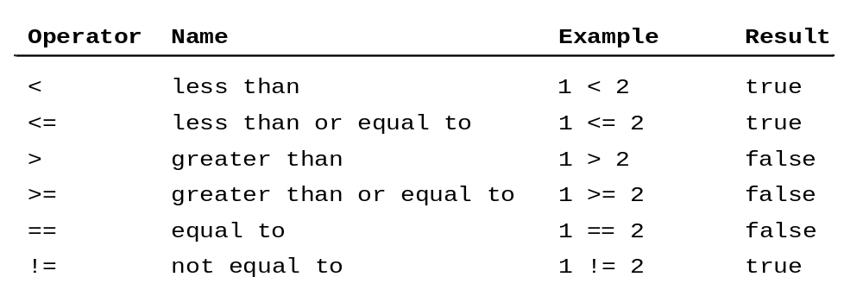
Comparison Operators
The result of comparison is a Boolean value: true or false. A variable that holds a Boolean value is known as Boolean variable. The bool data type is used to declare Boolean variables.

Slide 5
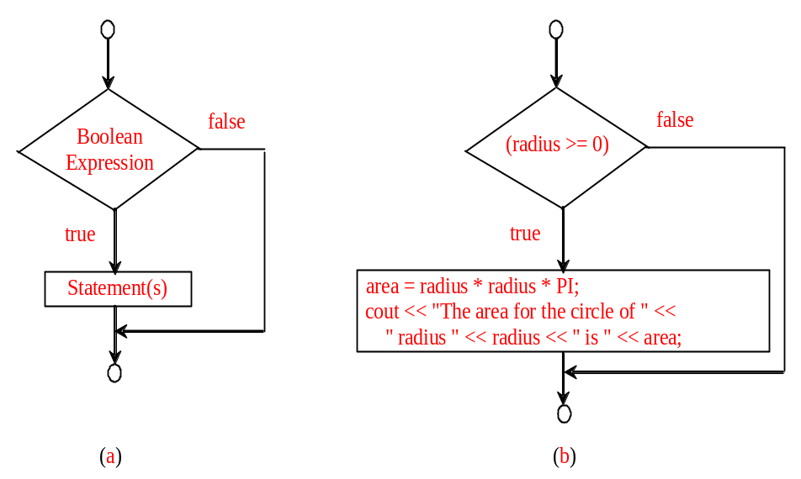
Simple if Statements
C++ provides the if statements, which can be used to control the execution path.
if (booleanExpression)
{
statement(s);
}
if (radius >= 0)
{
area = radius * radius * PI;
cout << "The area for the circle of " <<
" radius " << radius << " is " << area;
}
Notes:
Simple if statement is used just like this in C++. Here, boolean expression may be a comparison expression or any other expression with the value true or false. Only and only if the boolean expression evaluates to the value true, the statements enclosed in braces are executed.

Slide 6
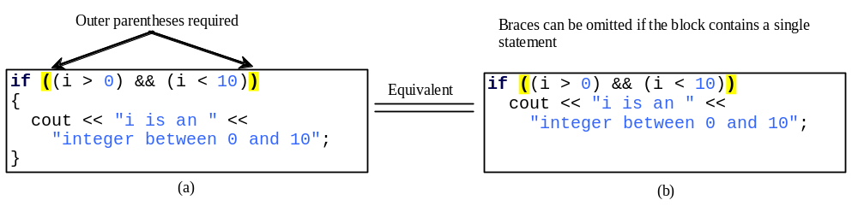
Note
The boolean expression is generally enclosed in parentheses. However, if the block contains a single statement, braces can be omitted.

Slide 7
Examples
Listing 3.1 gives a program that checks whether a number is even or odd. The program prompts the user to enter an integer (line 9) and displays “number is even” if it is even and “number is odd” if it is odd.
Test Boolean

Slide 8
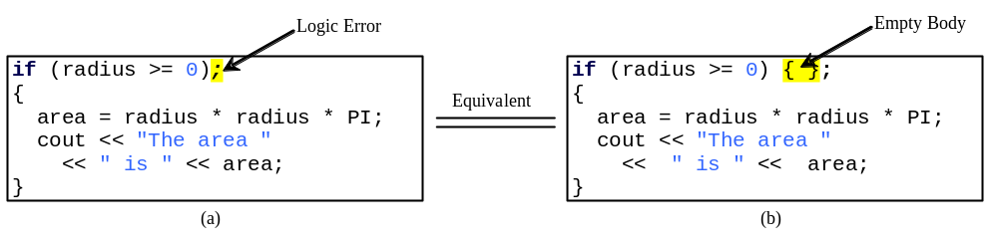
Caution
Adding a semicolon at the end of an if clause is a common mistake.
This mistake is hard to find, because it is not a compilation error or a runtime error, it is a logic error.
This error often occurs when you use the next-line block style.

Slide 9
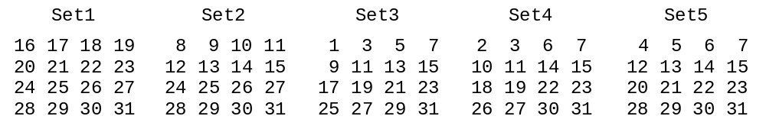
Examples
This section uses the if statements to write an interesting game program. The program can find your birth date. The program prompts you to answer whether your birth date is in the following five sets of numbers. Your birth date is the sum of the first numbers in the sets where your birthday appears.
GuessBirthDate
Notes:
Suppose your birth date is 19. 19 is in set1, set3 and set4. And the sum of the first numbers in these three sets are 19.

Slide 10
Logic Operators
Sometimes, the execution path is determined by a combination of several conditions. You can use logical operators to combine these conditions. Logical operators operate on Boolean values to create a new Boolean value.
Operator Name Description
! not logic negation
&& and logic conjunction
|| or logic disjunction

Slide 11
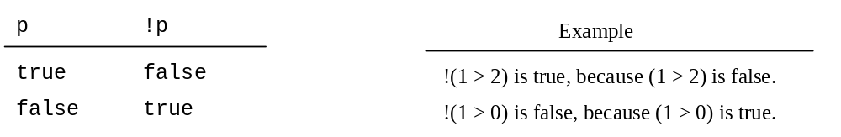
Truth Table for Operator !
The not (!) operator negates true to false and false to true.

Slide 12
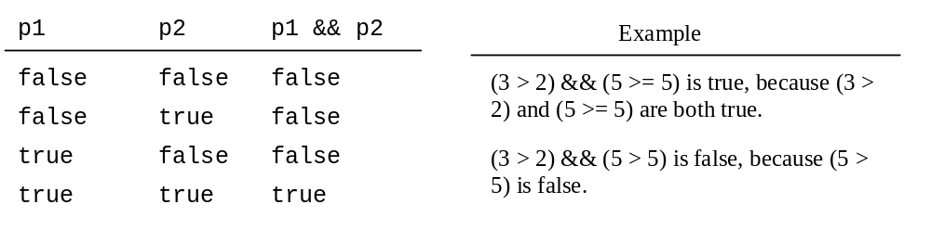
Truth Table for Operator &&
The and (&&) of two Boolean operands is true if and only if both operands are true.
Notes:
For operator and &&, one operand is false, the other operand is false. The result is false.

Slide 13
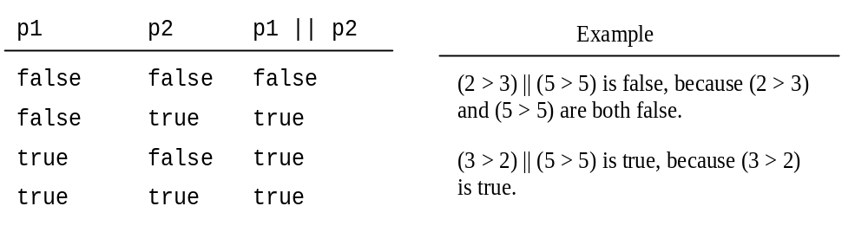
Truth Table for Operator ||
The or (||) of two Boolean operands is true at least one of the operands is true.

Slide 14
Examples
Listing 3.3 gives a program that checks whether a number is divisible by 2 and 3, whether a number is divisible by 2 or 3, and whether a number is divisible by 2 or 3 but not both:
TestBooleanOperators
Notes:
The first logic expression is to check whether a number is divisible by 2 and 3.
The second logic expression is to check whether a number is divisible by 2 or 3.
The third logic expression is to check whether a number is divisible by 2 or 3, but not both.

Slide 15
Short-Circuit Operator
When evaluating p1 && p2, C++ first evaluates p1 and then evaluates p2 if p1 is true; if p1 is false, it does not evaluate p2. When evaluating p1 || p2, C++ first evaluates p1 and then evaluates p2 if p1 is false; if p1 is true, it does not evaluate p2. Therefore, && is referred to as the conditional or short-circuit AND operator, and || is referred to as the conditional or short-circuit OR operator.
Notes:
See an example.

Slide 16
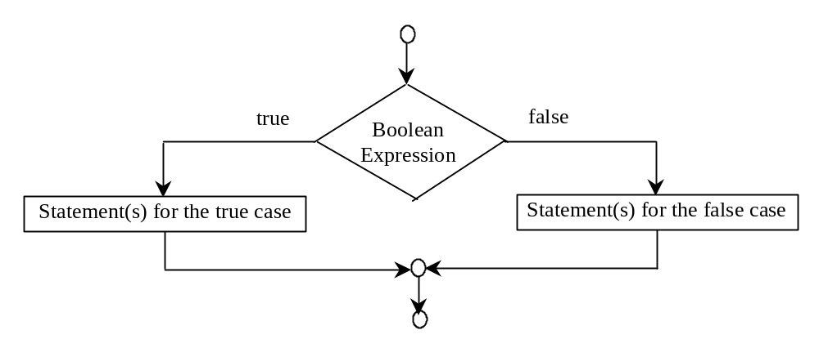
The if...else Statement
When the condition is false, we can use the if … else statement to take alternative actions.
if (booleanExpression)
{
statement(s)-for-the-true-case;
}
else
{
statement(s)-for-the-false-case;
}
Notes:
The if … else statement works like this. When the Boolean expression evaluates to the value true, the statements for the true case are executed. When the Boolean expression evaluates to the value false, the statements for the false case are executed.

Slide 17
Examples
Listing 3.4 presents a program that lets the user enter a year and checks whether it is a leap year.
A year is a leap year if it is divisible by 4 but not by 100 or if it is divisible by 400. So you can use the following Boolean expression to check whether a year is a leap year:
(year % 4 == 0 && year % 100 != 0) || (year % 400 == 0)
LeapYear

Slide 18
Nested if Statements
The statement in an if or if …else statement can be any legal C++ statement, including another if or if…else statement. The inner if statement is said to be nested inside the outer if statement. And the inner if statement can contain another if statement.
if (i > k)
{
if (j > k)
cout << "i and j are greater than k";
}
else
cout << "i is less than or equal to k";
Notes:
The statements for the true case of the outer if …else statement is an if statement.

Slide 19
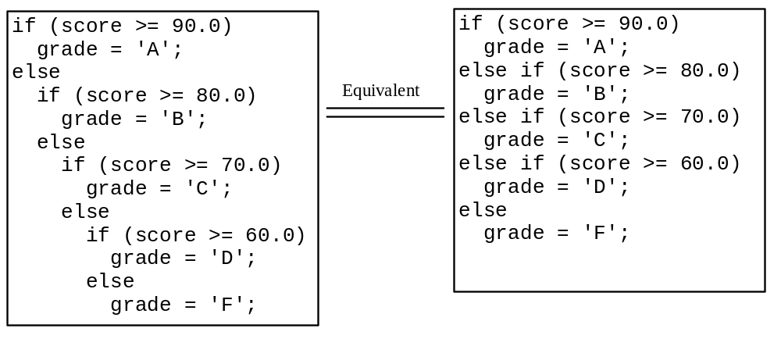
Multiple Alternative if Statements
The nested if statement can be used to implement multiple alternatives. The following example a letter grade to the variable grade according to the score.

Slide 20
Trace if-else statement
animation
Suppose score is 70.0
The condition is false
if (score >= 90.0)
grade = 'A';
else if (score >= 80.0)
grade = 'B';
else if (score >= 70.0)
grade = 'C';
else if (score >= 60.0)
grade = 'D';
else
grade = 'F';

Slide 21
Trace if-else statement
animation
Suppose score is 70.0
The condition is false
if (score >= 90.0)
grade = 'A';
else if (score >= 80.0)
grade = 'B';
else if (score >= 70.0)
grade = 'C';
else if (score >= 60.0)
grade = 'D';
else
grade = 'F';

Slide 22
Trace if-else statement
animation
Suppose score is 70.0
The condition is true
if (score >= 90.0)
grade = 'A';
else if (score >= 80.0)
grade = 'B';
else if (score >= 70.0)
grade = 'C';
else if (score >= 60.0)
grade = 'D';
else
grade = 'F';

Slide 23
Trace if-else statement
animation
Suppose score is 70.0
grade is C
if (score >= 90.0)
grade = 'A';
else if (score >= 80.0)
grade = 'B';
else if (score >= 70.0)
grade = 'C';
else if (score >= 60.0)
grade = 'D';
else
grade = 'F';

Slide 24
Trace if-else statement
animation
Suppose score is 70.0
Exit the if statement
if (score >= 90.0)
grade = 'A';
else if (score >= 80.0)
grade = 'B';
else if (score >= 70.0)
grade = 'C';
else if (score >= 60.0)
grade = 'D';
else
grade = 'F';

Slide 25
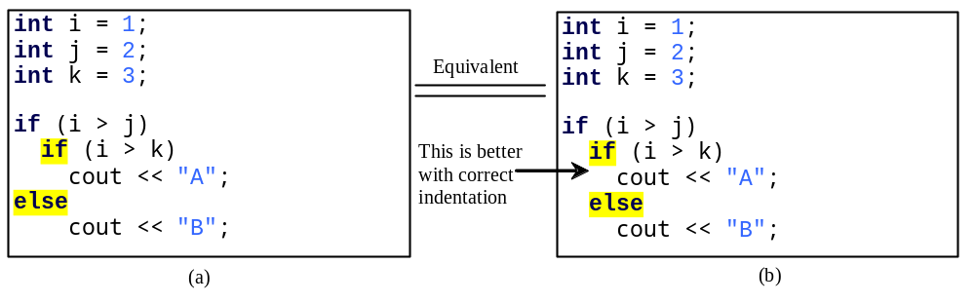
Note
The else clause matches the most recent if clause in the same block.
Notes:
According to the matching rule, the outer is an if statement and inner is an if…else statement. So, both ‘A’ and ‘B’ can not be displayed in the console.

Slide 26
Note, cont.
Nothing is printed from the preceding statement. To force the else clause to match the first if clause, you must add a pair of braces:
  int i = 1; int j = 2; int k = 3;
  if (i > j)
  {
  if (i > k)
  cout << "A";
  }
  else
  cout << "B";
This statement prints B.

Slide 27
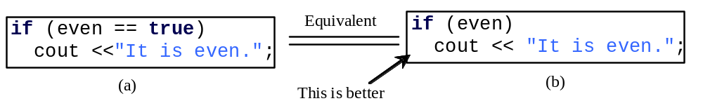
CAUTION
To test whether a bool variable is true or false in a test condition, it is redundant to use the equality comparison operator in code (a). Instead, it is better to use the bool variable directly, as shown in code (b).

Slide 28
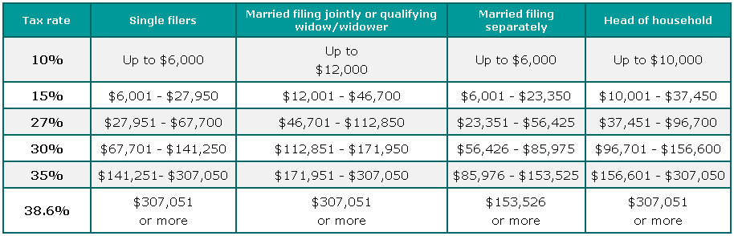
Example: Computing Taxes
The US federal personal income tax is calculated based on the filing status and taxable income. There are four filing statuses: single filers, married filing jointly, married filing separately, and head of household. The tax rates for 2002 are shown in Table 3.6.
Notes:
Filing status : 报税身份 taxable income: 应税额
From this table, we can see that there are multiple alternatives to be implemented. For filing status, there are single filers, married filling jointly, married separately and head of household. For tax rate, there are 10%, 15%,. 27%, 30% and 35%.

Slide 29
Example: Computing Taxes, cont.
if (status == 0)
{
// Compute tax for single filers
}
else if (status == 1)
{
// Compute tax for married file jointly
}
else if (status == 2)
{
// Compute tax for married file separately
}
else if (status == 3)
{
// Compute tax for head of household
}
else
{
// Display wrong status
}
ComputeTaxWithSelectionStatement

Slide 30
Example: A Simple Math Learning Tool
This example creates a program for a first grader to practice subtractions. The program randomly generates two single-digit integers number1 and number2 with number1 >= number2 and displays a question such as “What is 9 – 2?” to the student, as shown in the sample output. After the student types the answer, the program displays a message to indicate whether the answer is correct.
SubtractionTutor

Slide 31
switch Statements (t.b.c.)
Overuse of nested if statements make a program difficult to read. C++ provides a switch statement to handle multiple conditions efficiently. We can use the following switch statement to replace the nested if statements in Listing 3.5.
switch (status)
{
case 0: compute taxes for single filers;
break;
case 1: compute taxes for married file jointly;
break;
case 2: compute taxes for married file separately;
break;
case 3: compute taxes for head of household;
break;
default: System.out.println("Errors: invalid status");
System.exit(0);
}
Notes:
clearer

Slide 32
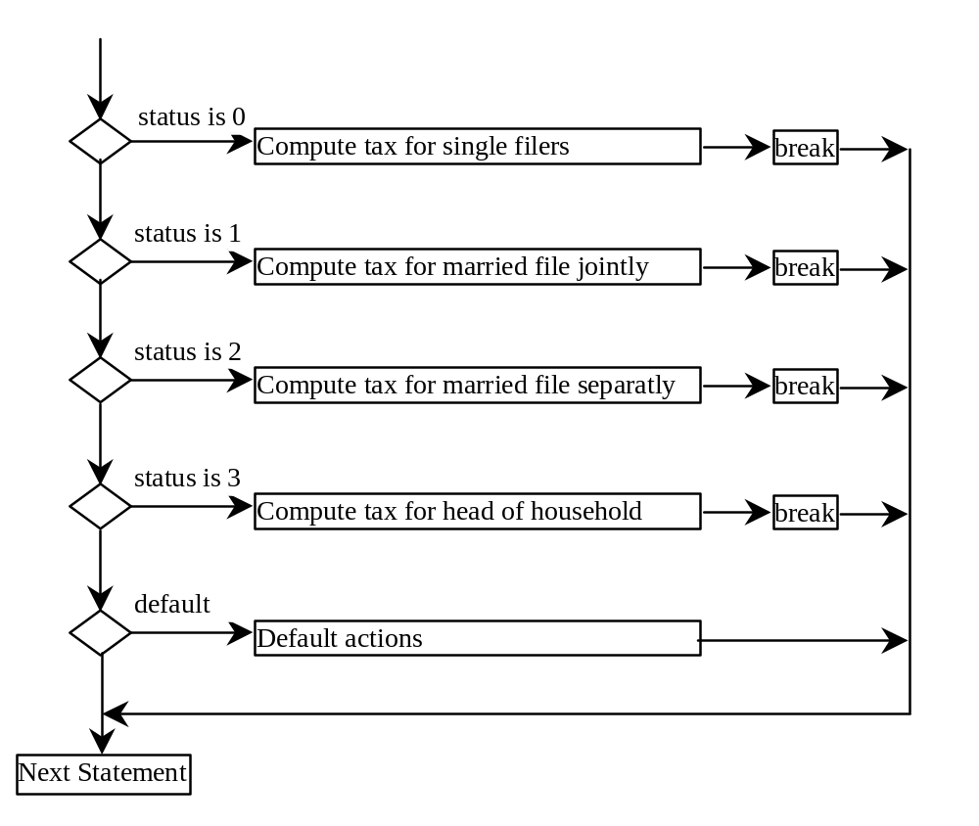
switch Statement Flow Chart

Slide 33
switch Statement Rules
The switch-expression must yield a value of char, byte, short, or int type and must always be enclosed in parentheses.
switch (switch-expression) {
case value1: statement(s)1;
break;
case value2: statement(s)2;
break;
…
case valueN: statement(s)N;
break;
default: statement(s)-for-default;
}
The value1, ..., and valueN must have the same data type as the value of the switch-expression. The resulting statements in the case statement are executed when the value in the case statement matches the value of the switch-expression. Note that value1, ..., and valueN are constant expressions, meaning that they cannot contain variables in the expression, such as 1 + x.

Slide 34
switch Statement Rules
The keyword break is optional, but it should be used at the end of each case in order to terminate the remainder of the switch statement. If the break statement is not present, the next case statement will be executed.
switch (switch-expression) {
case value1: statement(s)1;
break;
case value2: statement(s)2;
break;
…
case valueN: statement(s)N;
break;
default: statement(s)-for-default;
}
The default case, which is optional, can be used to perform actions when none of the specified cases matches the switch-expression.
The case statements are executed in sequential order, but the order of the cases (including the default case) does not matter. However, it is good programming style to follow the logical sequence of the cases and place the default case at the end.

Slide 35
Trace switch statement
animation
Suppose ch is 'a':
switch (ch) {
case 'a': cout << ch;
case 'b': cout << ch;
case 'c': cout << ch;
}

Slide 36
Trace switch statement
animation
ch is 'a':
switch (ch) {
case 'a': cout << ch;
case 'b': cout << ch;
case 'c': cout << ch;
}

Slide 37
Trace switch statement
animation
Execute this line
switch (ch) {
case 'a': cout << ch;
case 'b': cout << ch;
case 'c': cout << ch;
}

Slide 38
Trace switch statement
animation
Execute this line
switch (ch) {
case 'a': cout << ch;
case 'b': cout << ch;
case 'c': cout << ch;
}

Slide 39
Trace switch statement
animation
Execute this line
switch (ch) {
case 'a': cout << ch;
case 'b': cout << ch;
case 'c': cout << ch;
}

Slide 40
Trace switch statement
animation
Execute next statement
switch (ch) {
case 'a': cout << ch;
case 'b': cout << ch;
case 'c': cout << ch;
}
Next statement;

Slide 41
Trace switch statement
animation
Suppose ch is 'a':
switch (ch) {
case 'a': cout << ch;
break;
case 'b': cout << ch;
break;
case 'c': cout << ch;
}

Slide 42
Trace switch statement
animation
ch is 'a':
switch (ch) {
case 'a': cout << ch;
break;
case 'b': cout << ch;
break;
case 'c': cout << ch;
}

Slide 43
Trace switch statement
animation
Execute this line
switch (ch) {
case 'a': cout << ch;
break;
case 'b': cout << ch;
break;
case 'c': cout << ch;
}

Slide 44
Trace switch statement
animation
Execute this line
switch (ch) {
case 'a': cout << ch;
break;
case 'b': cout << ch;
break;
case 'c': cout << ch;
}

Slide 45
Trace switch statement
animation
Execute next statement
switch (ch) {
case 'a': cout << ch;
break;
case 'b': cout << ch;
break;
case 'c': cout << ch;
}
Next statement;

Slide 46
Conditional Operator
The syntax for conditional operator is in the following. The result a conditional expression is exp1 if boolExp is true; otherwise, the result is exp2.
(booleanExp) ? exp1 : exp2

Slide 47
Conditional Operator
if (x > 0)
y = 1
else
y = -1;
is equivalent to
y = (x > 0) ? 1 : -1;

Slide 48
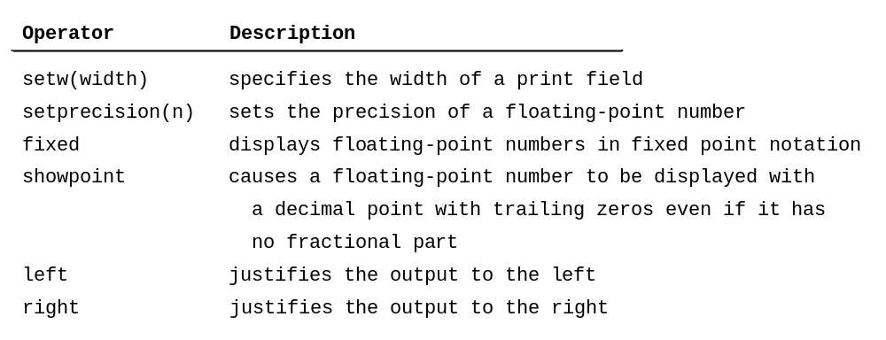
Formatting Output
We have already known how to display console output using the std::cout object. C++ provides additional functions for formatting how a value is printed. These functions are called stream manipulators and are included in the iomanip header file.

Slide 49
Operator Precedence and Associativity
How to evaluate 3 + 4 * 4 > 5 * (4 + 3) – 1?
Operator precedence and associativity determine the order in which operators are evaluated. The expression in the parentheses is evaluated first. When evaluating an expression without parentheses, the operators are applied according to precedence rule and the associativity rule.
Multiplication has higher precedence than addition. Addition has higher precedence than greater than (>).

Slide 50
Operator Precedence and Associativity
If operators with the same precedence are next to each other, their associativity determine the order of evaluation. All binary operators except assignment operators are left-associativity.
a-b+c-d equivalent ((a-b)+c)-d
Assignment operators are right-associativity. Therefore,
a=b+=c=5 equivalent a=(b+=(c=5))
Notes:
In this expression, we give the parentheses to determine the order that operators are applied.

Slide 51
Operator Precedence
var++, var--
+, - (Unary plus and minus), ++var,--var
(type) Casting
! (Not)
*, /, % (Multiplication, division, and remainder)
+, - (Binary addition and subtraction)
<, <=, >, >= (Comparison)
==, !=; (Equality)
&& (Conditional AND) Short-circuit AND
|| (Conditional OR) Short-circuit OR
=, +=, -=, *=, /=, %= (Assignment operator)

Slide 52
Chapter Summary
The relational operators (<,<=,==,!=,>,>=) work with numbers and characters and yield a Boolean value. The Boolean operators &&, ||, and ! operate with Boolean values and variables.

Slide 53
Chapter Summary
When evaluating p1&&p2, C++ first evaluates p1 and then evaluates p2 if p1 is true. If p1 is false, the expression evaluates the value false and it does not evaluate p2. When evaluating p1||p2, C++ first evaluates p1 and then evaluates p2 if p1 is false. If p1 is true, the expression evaluates the value true and it does not evaluate p2.

Slide 54
Chapter Summary
Selection statements are used to building selections steps into programs. There are several types of selection statements: if statements, if…else statements, nested if statements, switch statements and conditional expressions.

Slide 55
Chapter Summary
The switch statement makes control decisions based on a switch expression of type char, byte, short or int, not float or double.

Slide 56
Chapter Summary
The keyword break is optional in a switch statement, but it is normally is used at the end of each case in order to terminate the remainder of the switch statement. If the break statement is not present, the next case statement will be executed.

Slide 57
Chapter Summary
The operators in expressions are evaluated in the order determined by the rules of parentheses, operator precedence and associativity.

Slide 58
Chapter Summary
Parentheses can be used to force the order of evaluation to occur in any sequence. Operators with higher precedence are evaluated earlier. The associativity of the operators determines the order of evaluation for operators with the same precedence. All binary operators except assignment operators are left-associative and assignment operators are right-associative.

